Slide 1
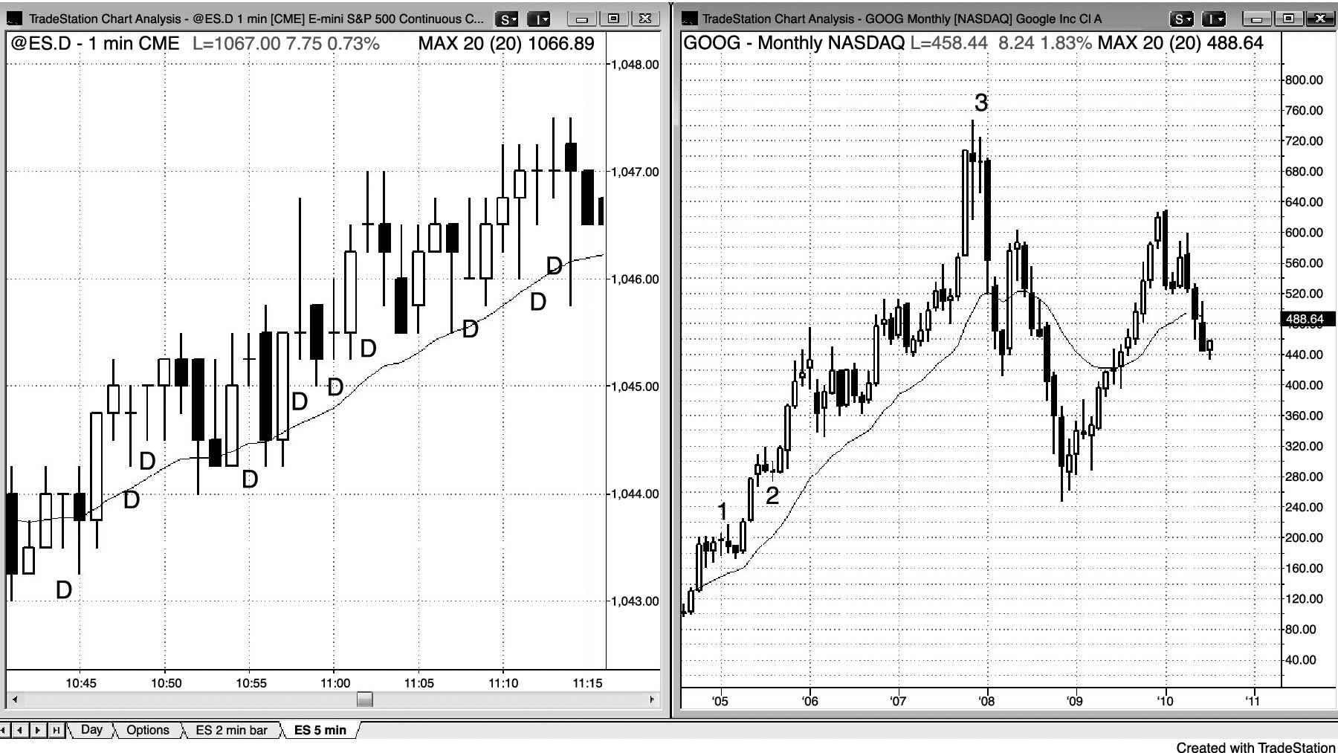
FIGURE 2.1 Dojis Are Rarely Perfect

Slide 2
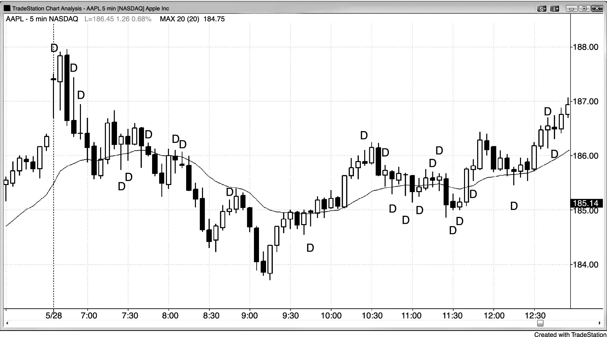
FIGURE 2.2 Intraday Dojis

Slide 3
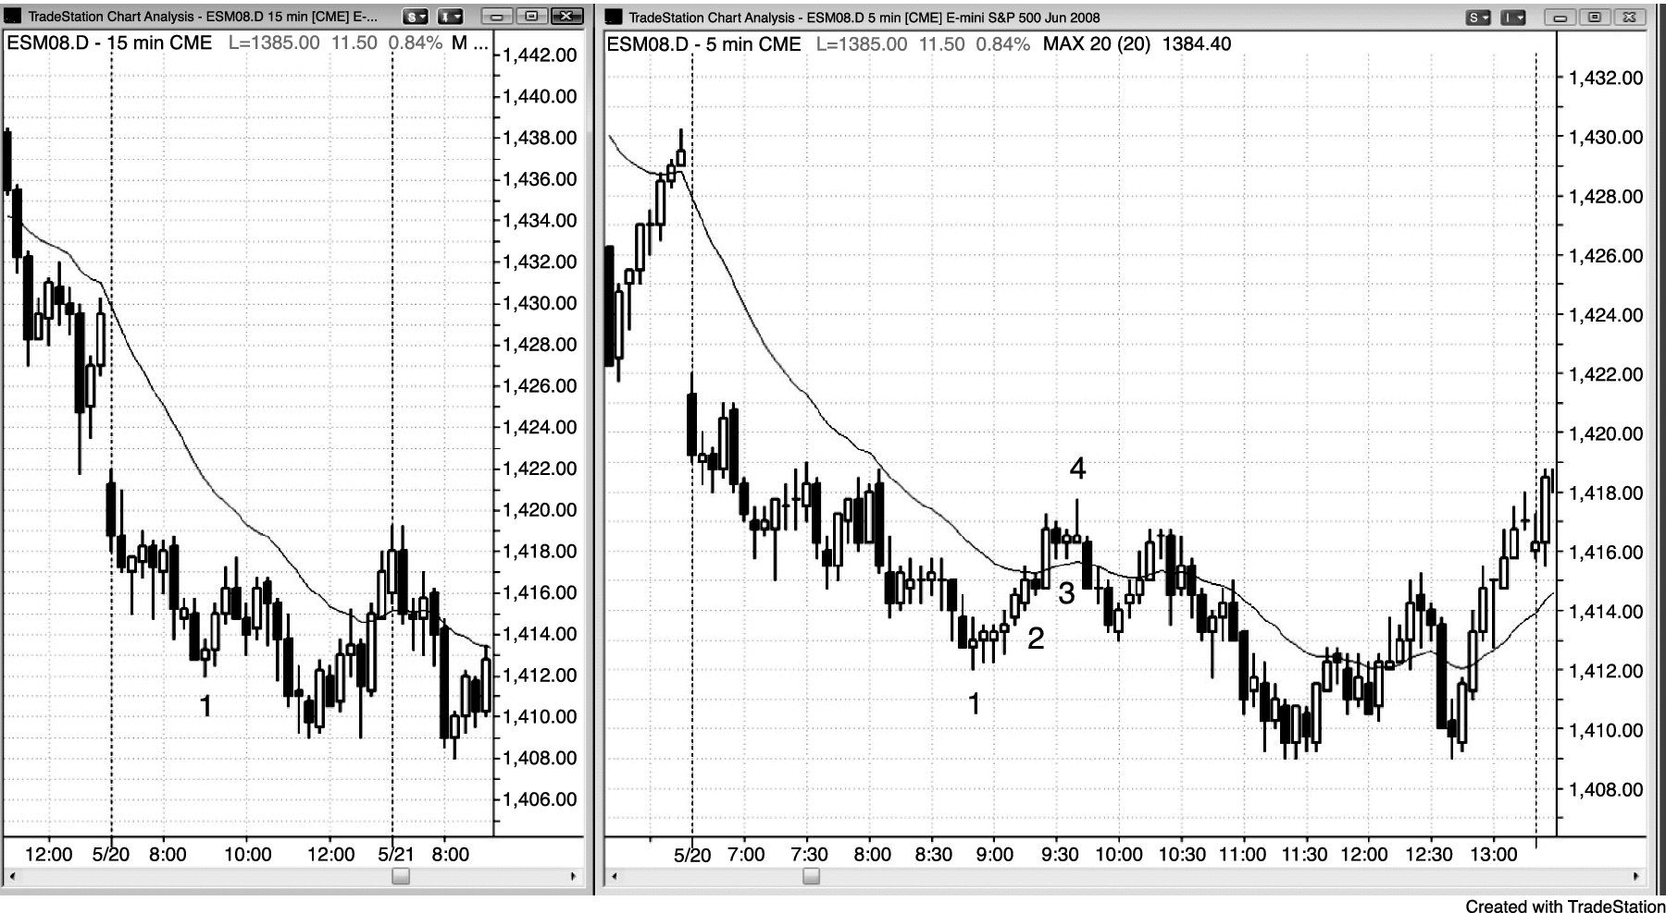
FIGURE 2.3 Trending Dojis

Slide 4
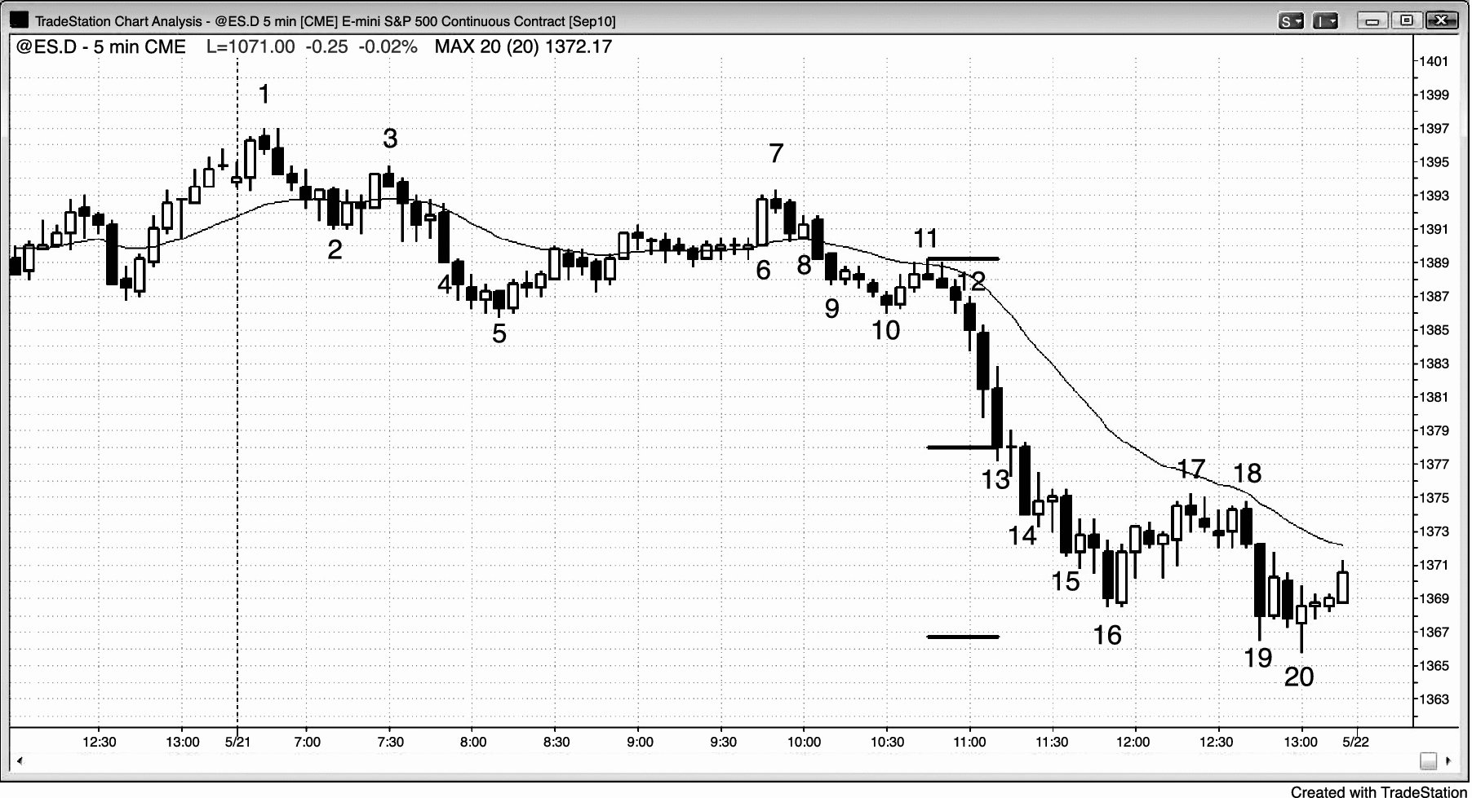
FIGURE 2.4 Trend Bars without a Trend

Slide 5
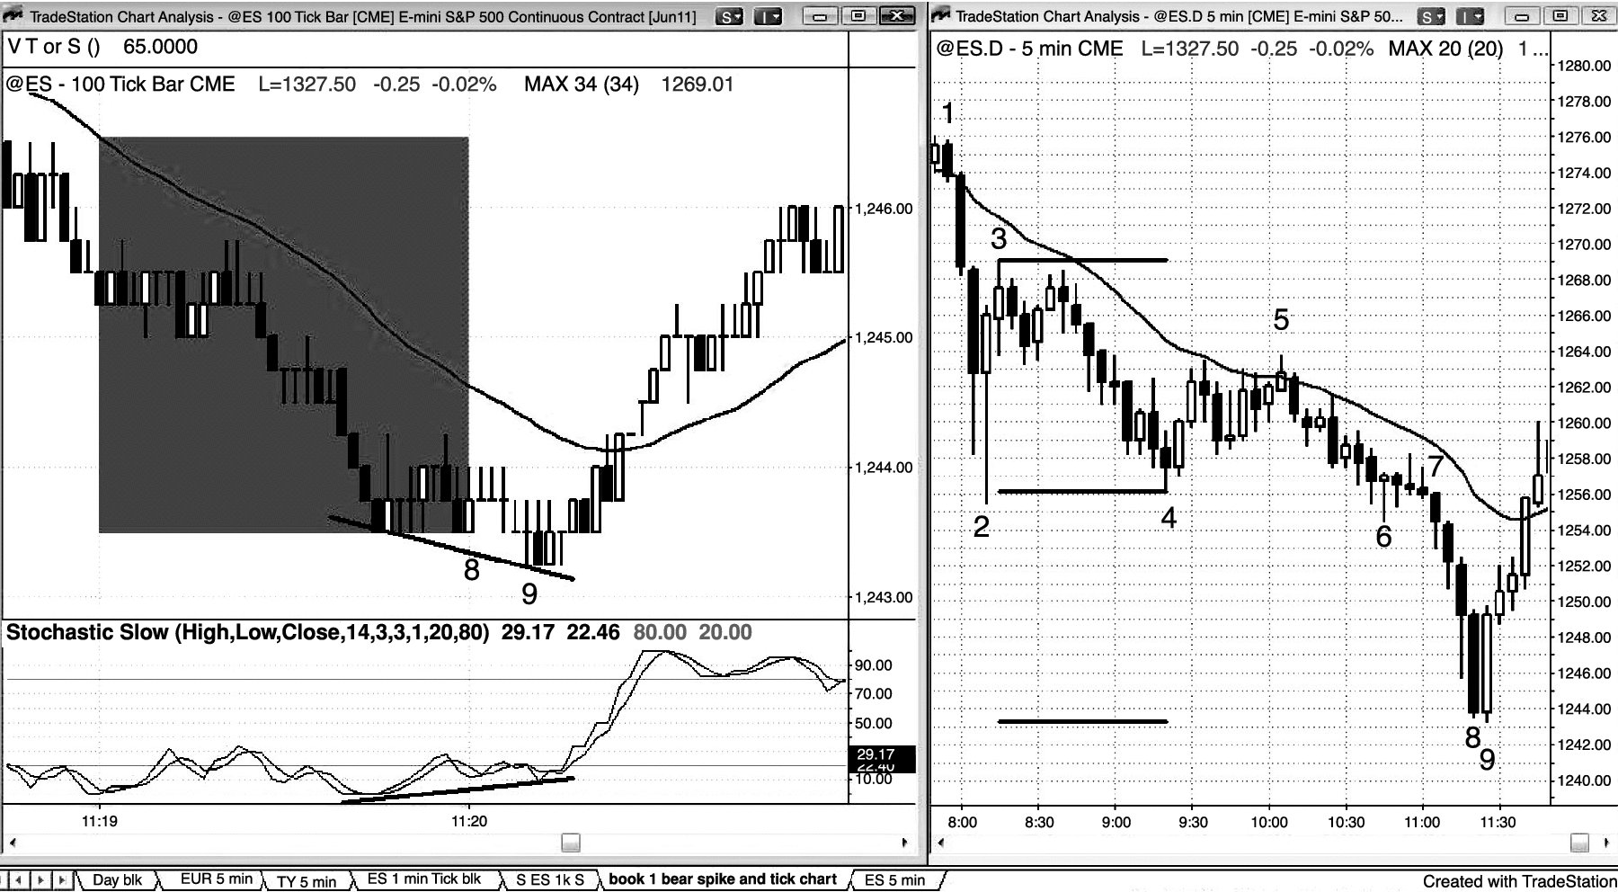
FIGURE 2.5 A Large Bear Trend Bar Can End a Bear Trend

Slide 6
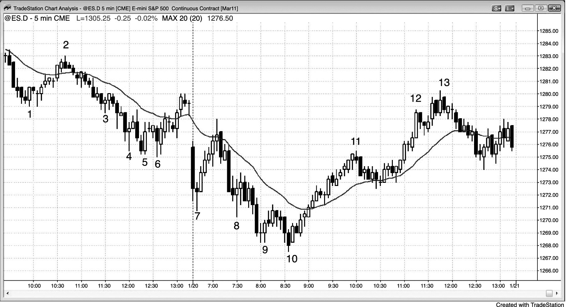
FIGURE 2.6 Trend Transitioning into Trading Range

